Slide 1
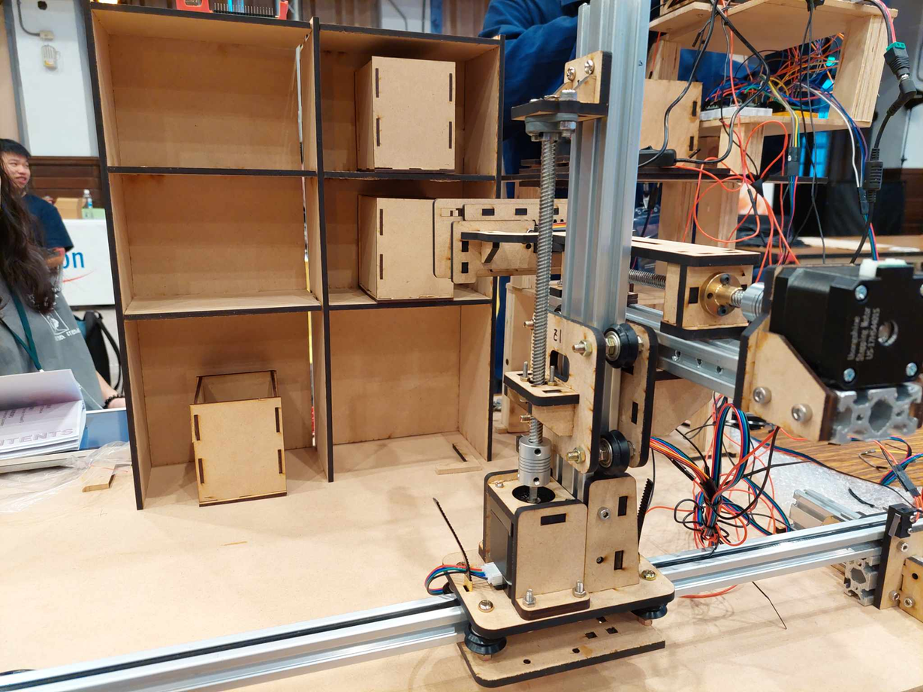
CTRL F
Autonomous smart storage robot
TEAM #41

Slide 2
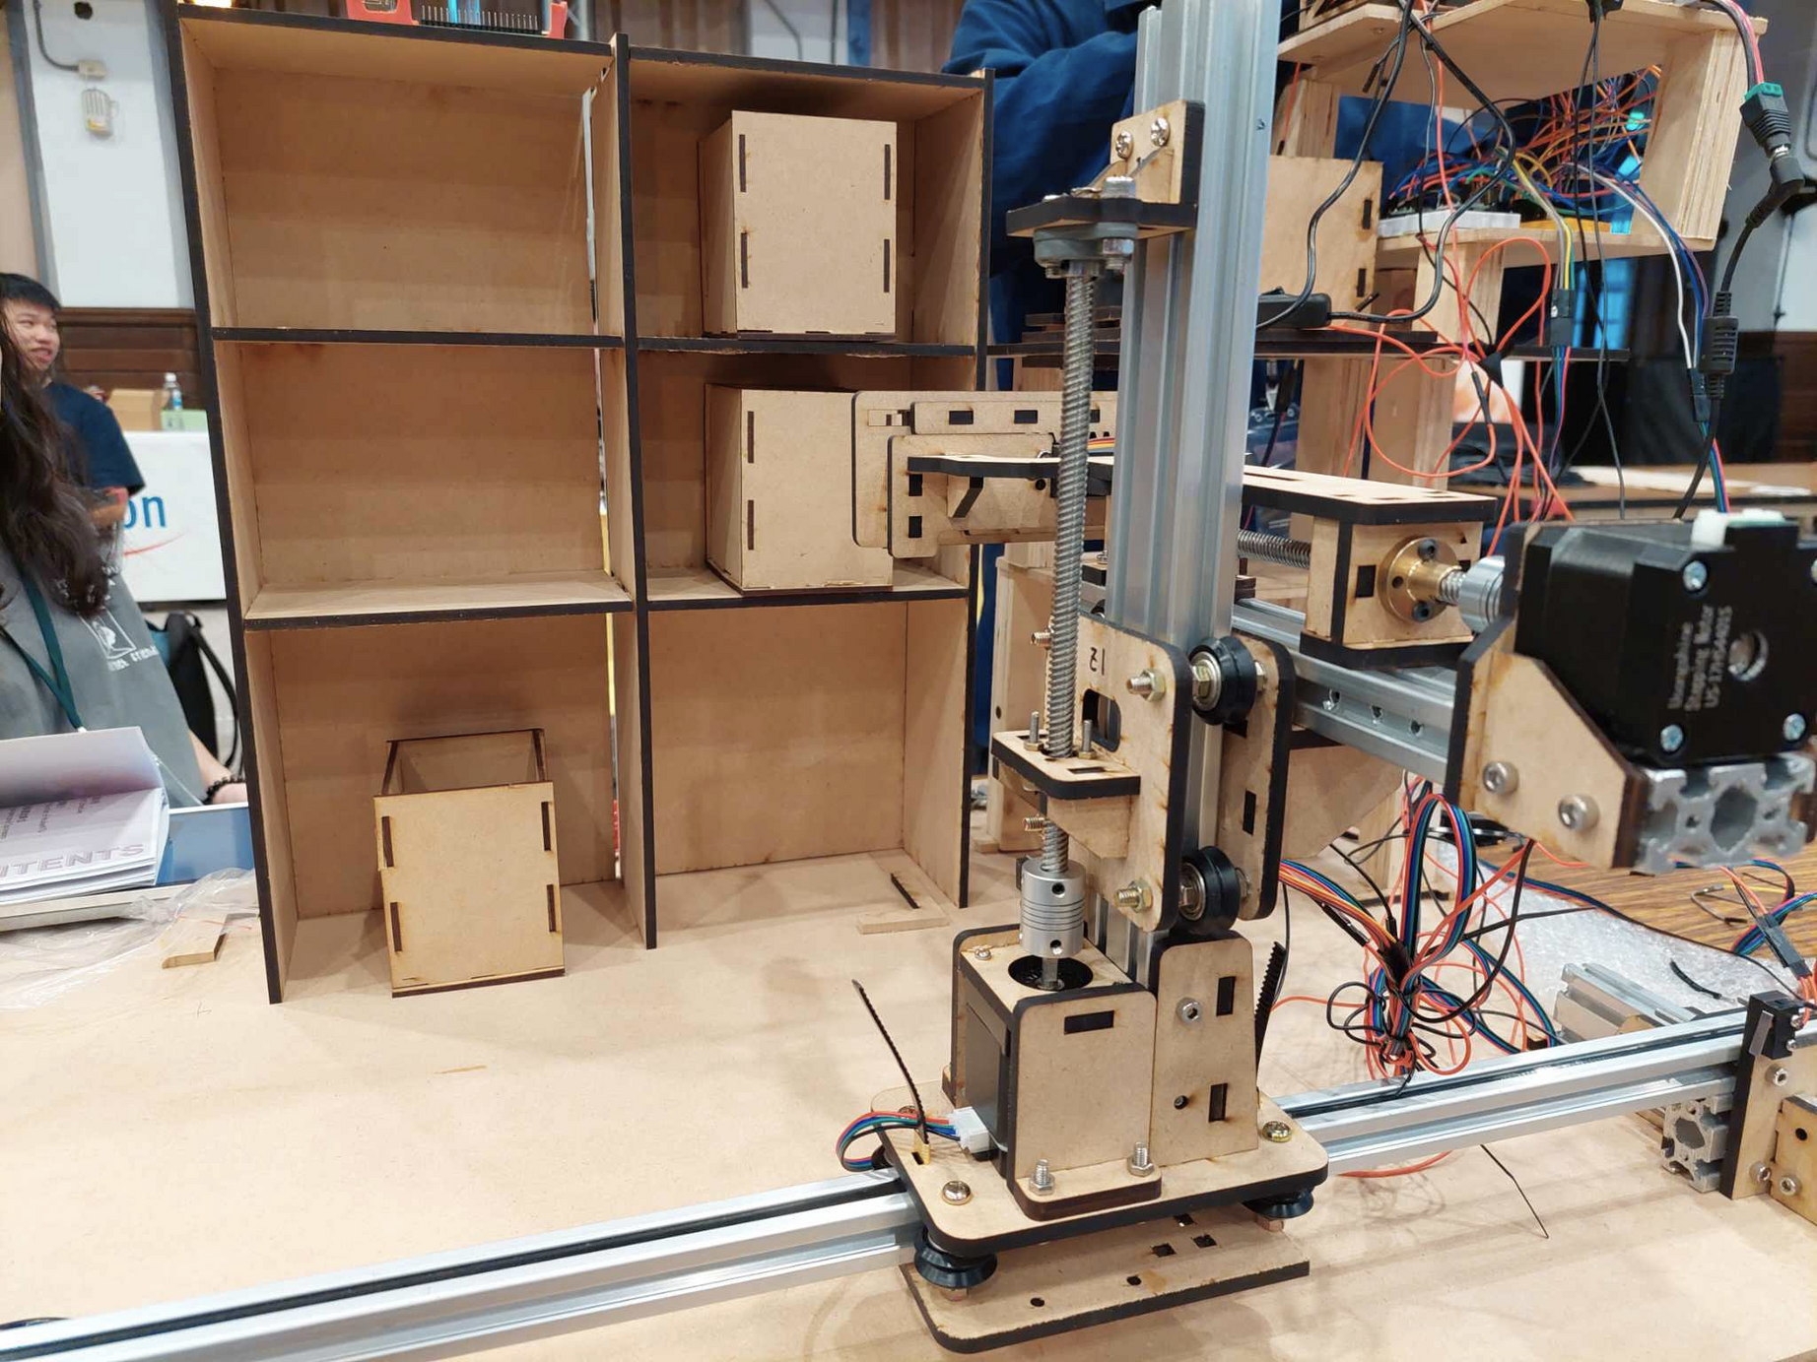
CONTENT
Motivation
Our service
Technical details
Mechanism
Control
App
CV
Future goals
Demo

Slide 3
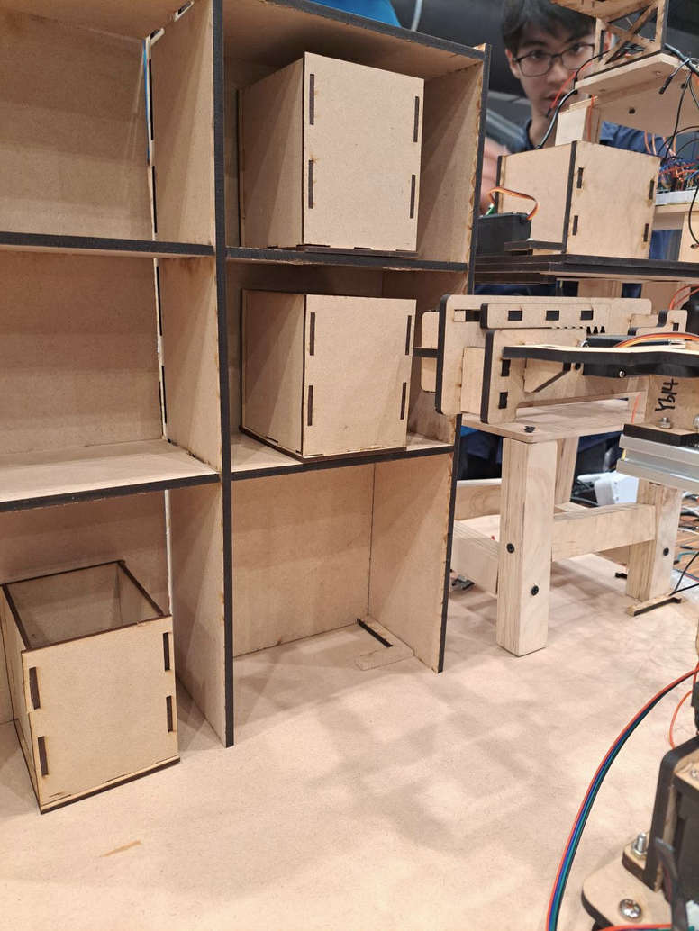
MOTIVATION
Your time is too valuable to waste.
Do you often find yourself forgetting where you put things?
Stop wasting time searching!
Our fully automated smart storage system not only stores your items but also sorts them and can even recommend things based on your habits, helping you work more efficiently.

Slide 4
LET US DO IT FOR YOU!

Slide 5
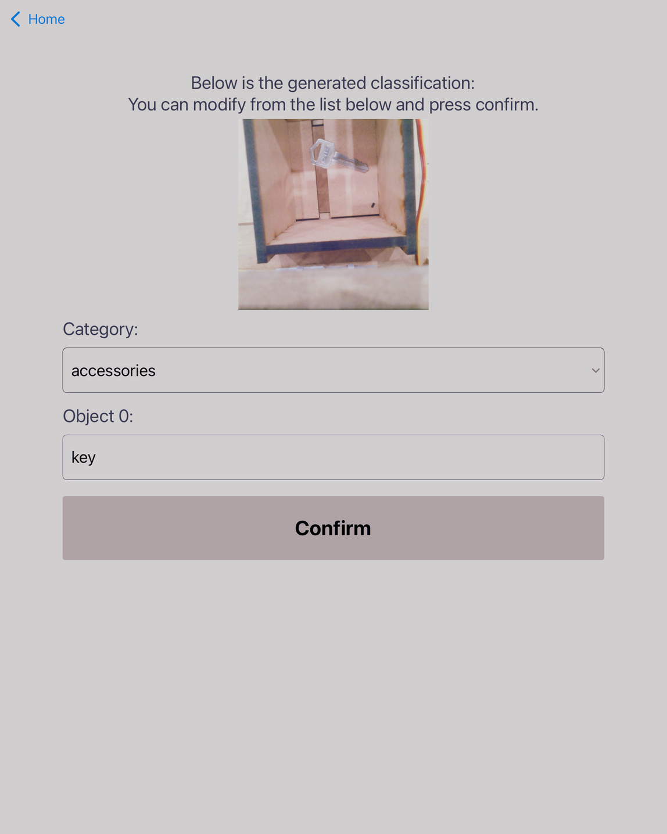




OUR SERVICE
Simple Automated Storage
One-tap storage via your phone
AI Smart Sorting
AI organizes your items,
saving you the trouble of tidying up.
Effortless Retrieval
Easily search by category and let the robot get your items for you, no more digging around
Customized Experience
Get item recommendations based on habits, and set schedules for automated retrieval

Slide 6
TECHNICAL DETAILS

Slide 7
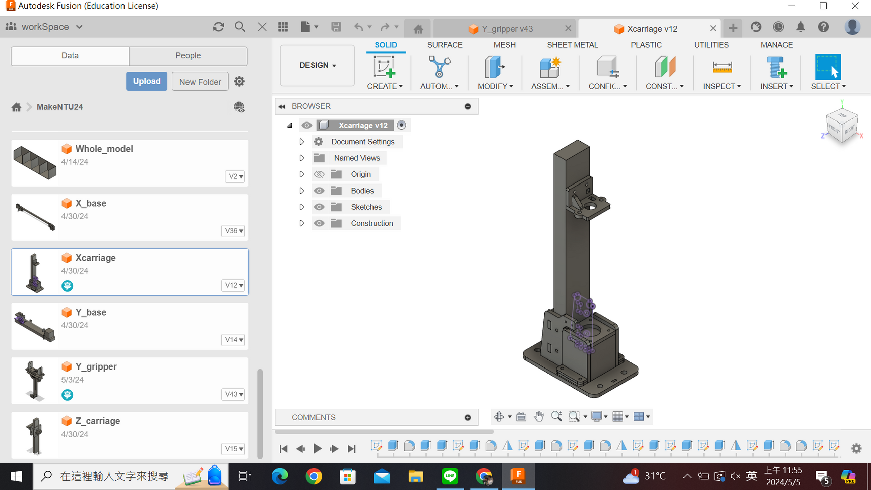
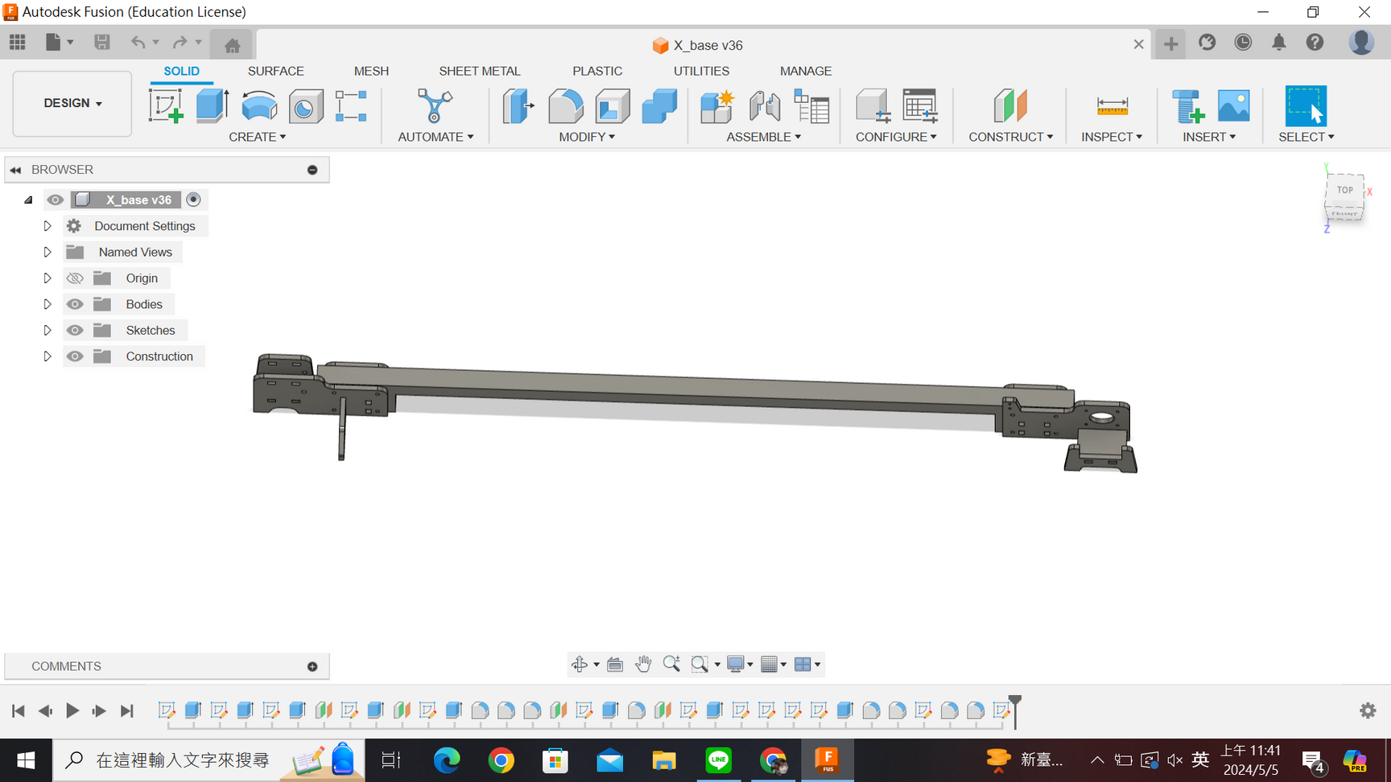
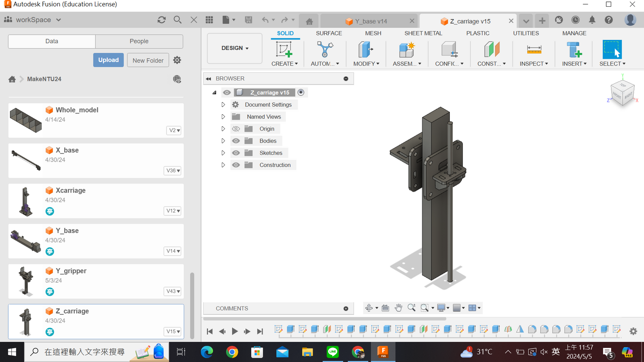
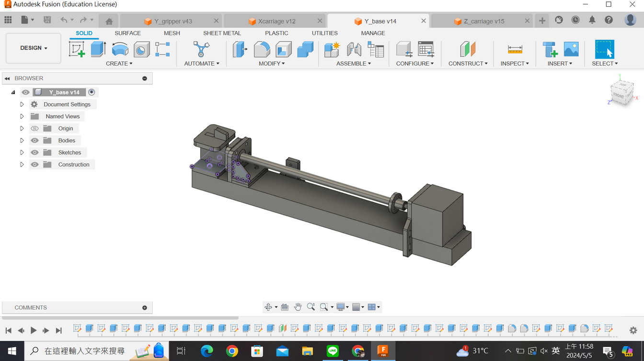
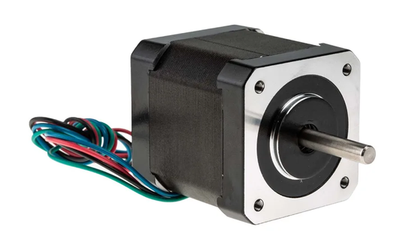
Z-axis
MECHANISM
LINEAR RAIL
Similar to the XYZ three-axis movement system in a 3D printer, the linear rail moves on the XZ plane. The grabber on the Y-axis then performs the gripping action.
X-axis: parallel to the cabinet
Z-axis platform
STEPPER MOTOR
Stepper motors, couplers, and lead screws are used to control the forward and backward movement of the Y and Z axes. The Z-axis is mounted on a pulley and belt system, allowing it to move along the X-axis.
y-axis: direction of getting objects from the cabinet

Slide 8
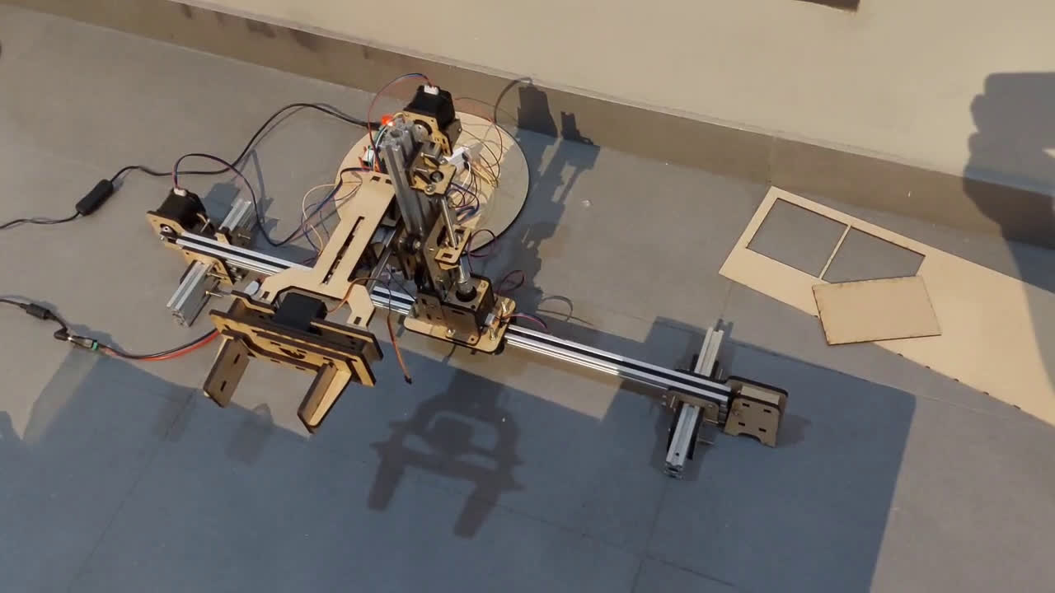
Z-axis
MECHANISM
Z-axis
X-axis
Y-axis

Slide 9
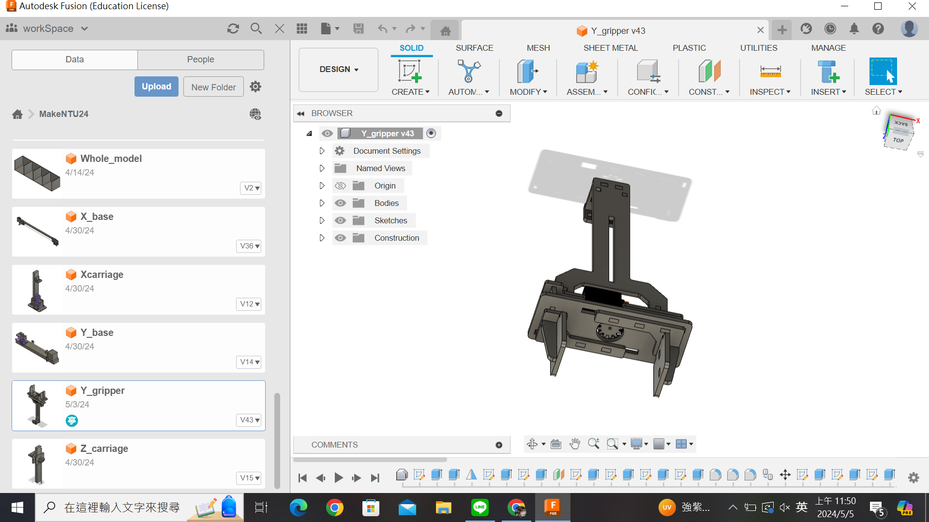
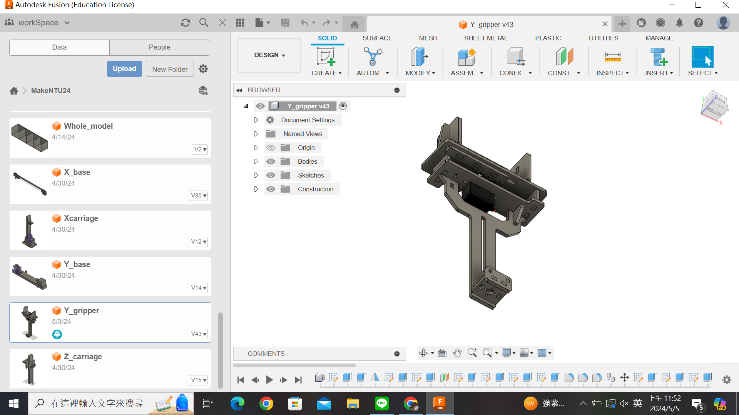
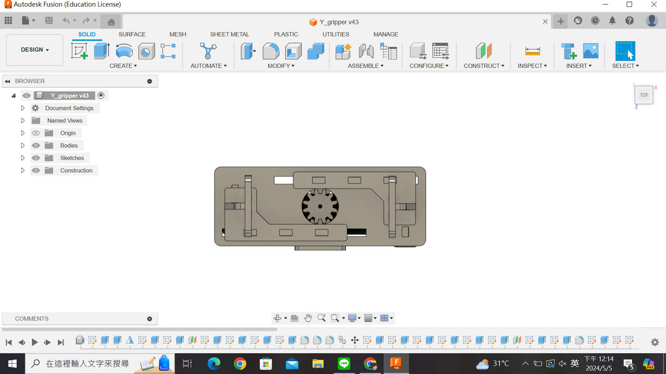
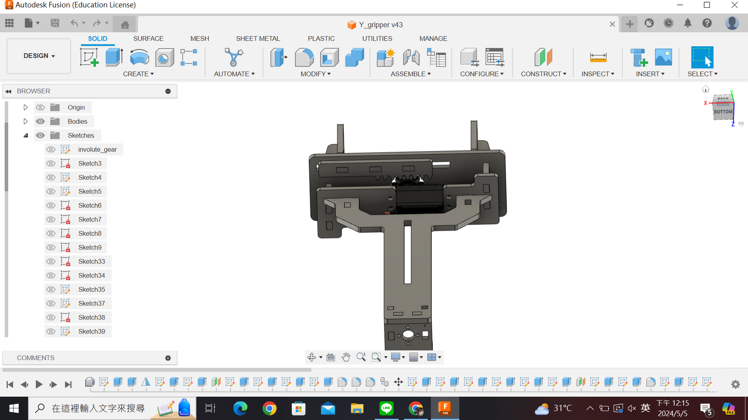
爪子
MECHANISM
GRIPPER
A servo motor is fitted with gears that engage with two racks, one above and one below. This causes the two sides of the gripper to move in opposite directions, allowing it to perform the "open" and "clamp" actions.

Slide 10
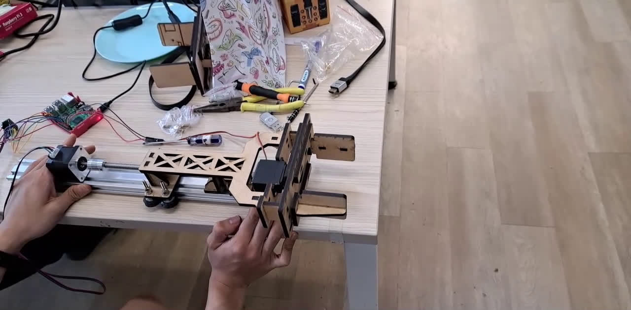
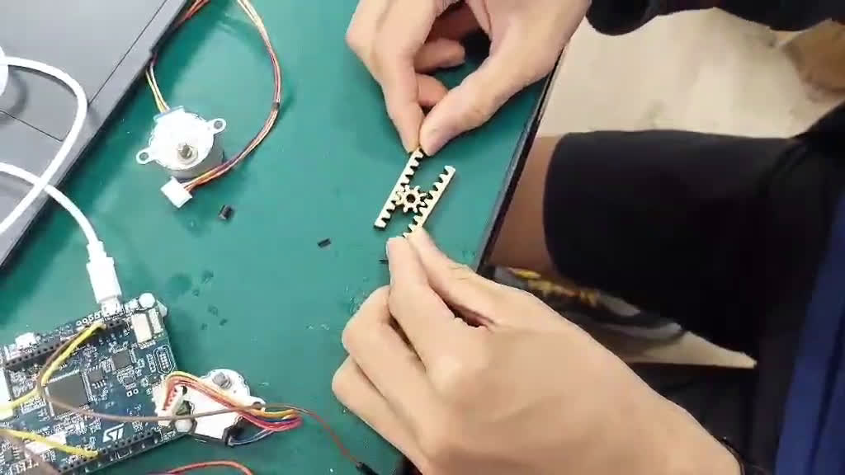
MECHANISM
GRIPPER
伺服馬達套上齒輪，搭配上下兩條尺條，讓夾子兩側朝不同方向移動，做到「張開」、「夾緊」的動作。

Slide 11
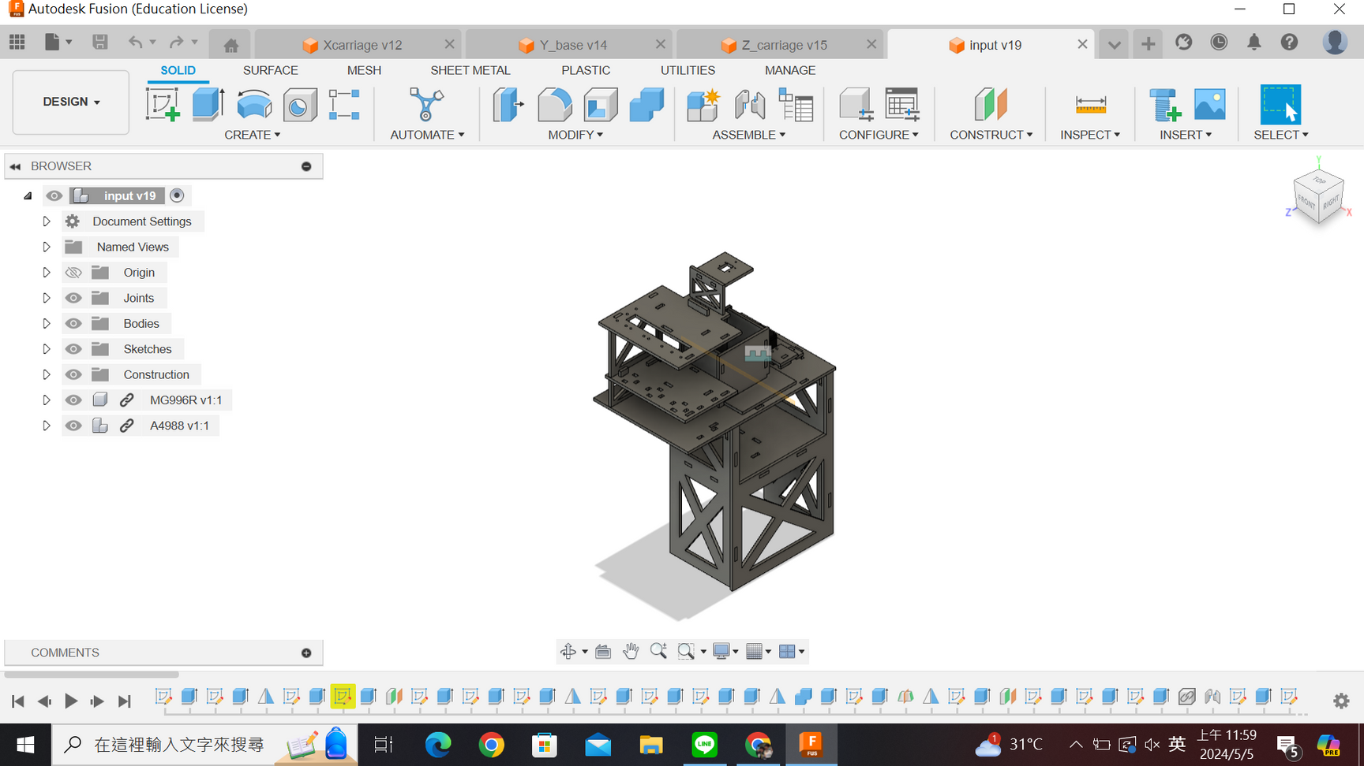
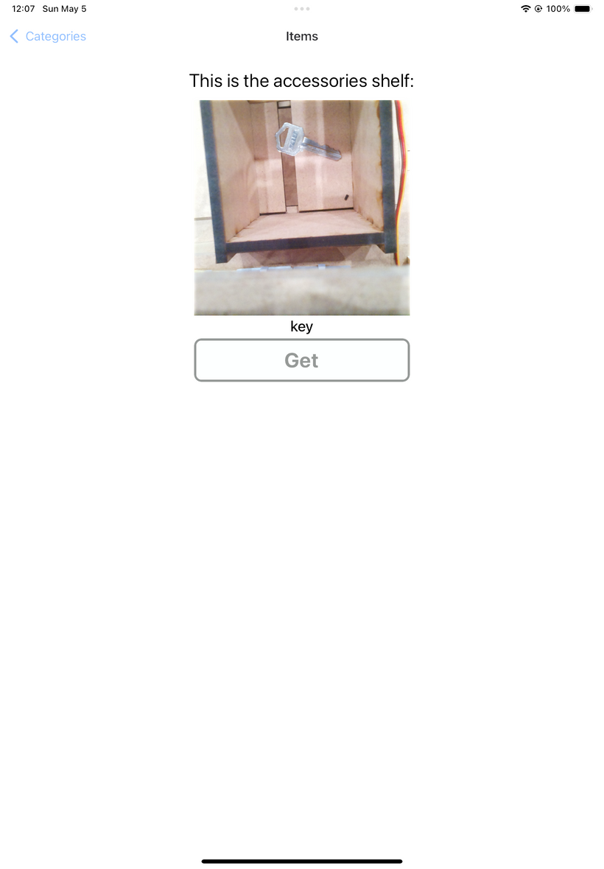
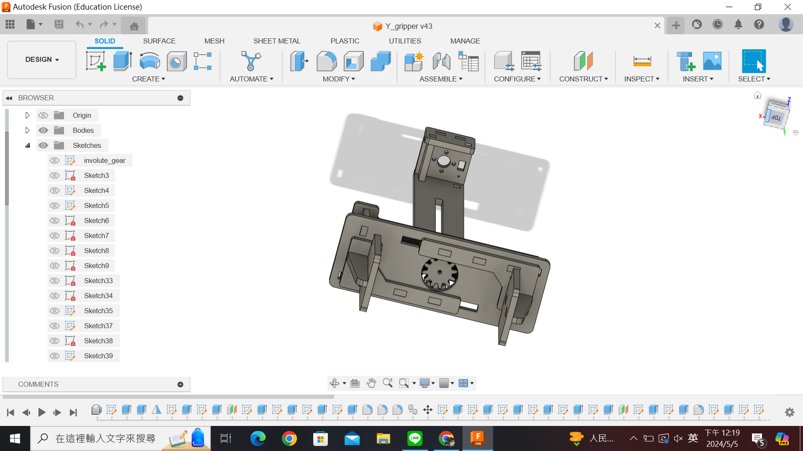
STEPS
Place the item in the container below the camera. After the camera takes a photo and sends the data, the bottom door opens and the item drops into the box below.
The app retrieves the data and, after confirmation from the user, saves it to the app's records.
The gripper picks up the box containing the item and moves to the target storage slot.

Slide 12
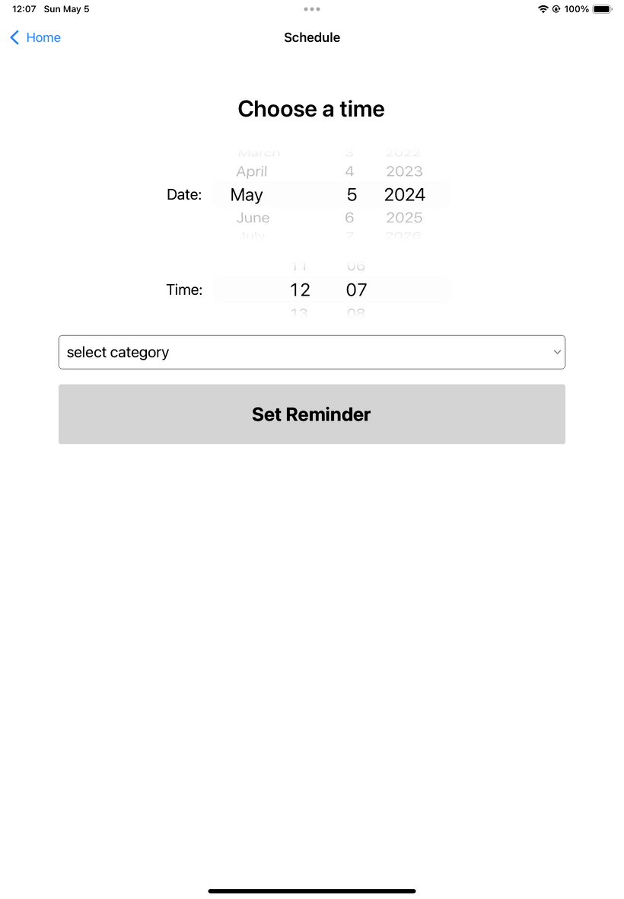
STEPS
The user selects either to retrieve the item immediately or to schedule a retrieval time.
The gripper picks up the box containing the item and moves it to the initial slot.
The user retrieves the item.

Slide 13
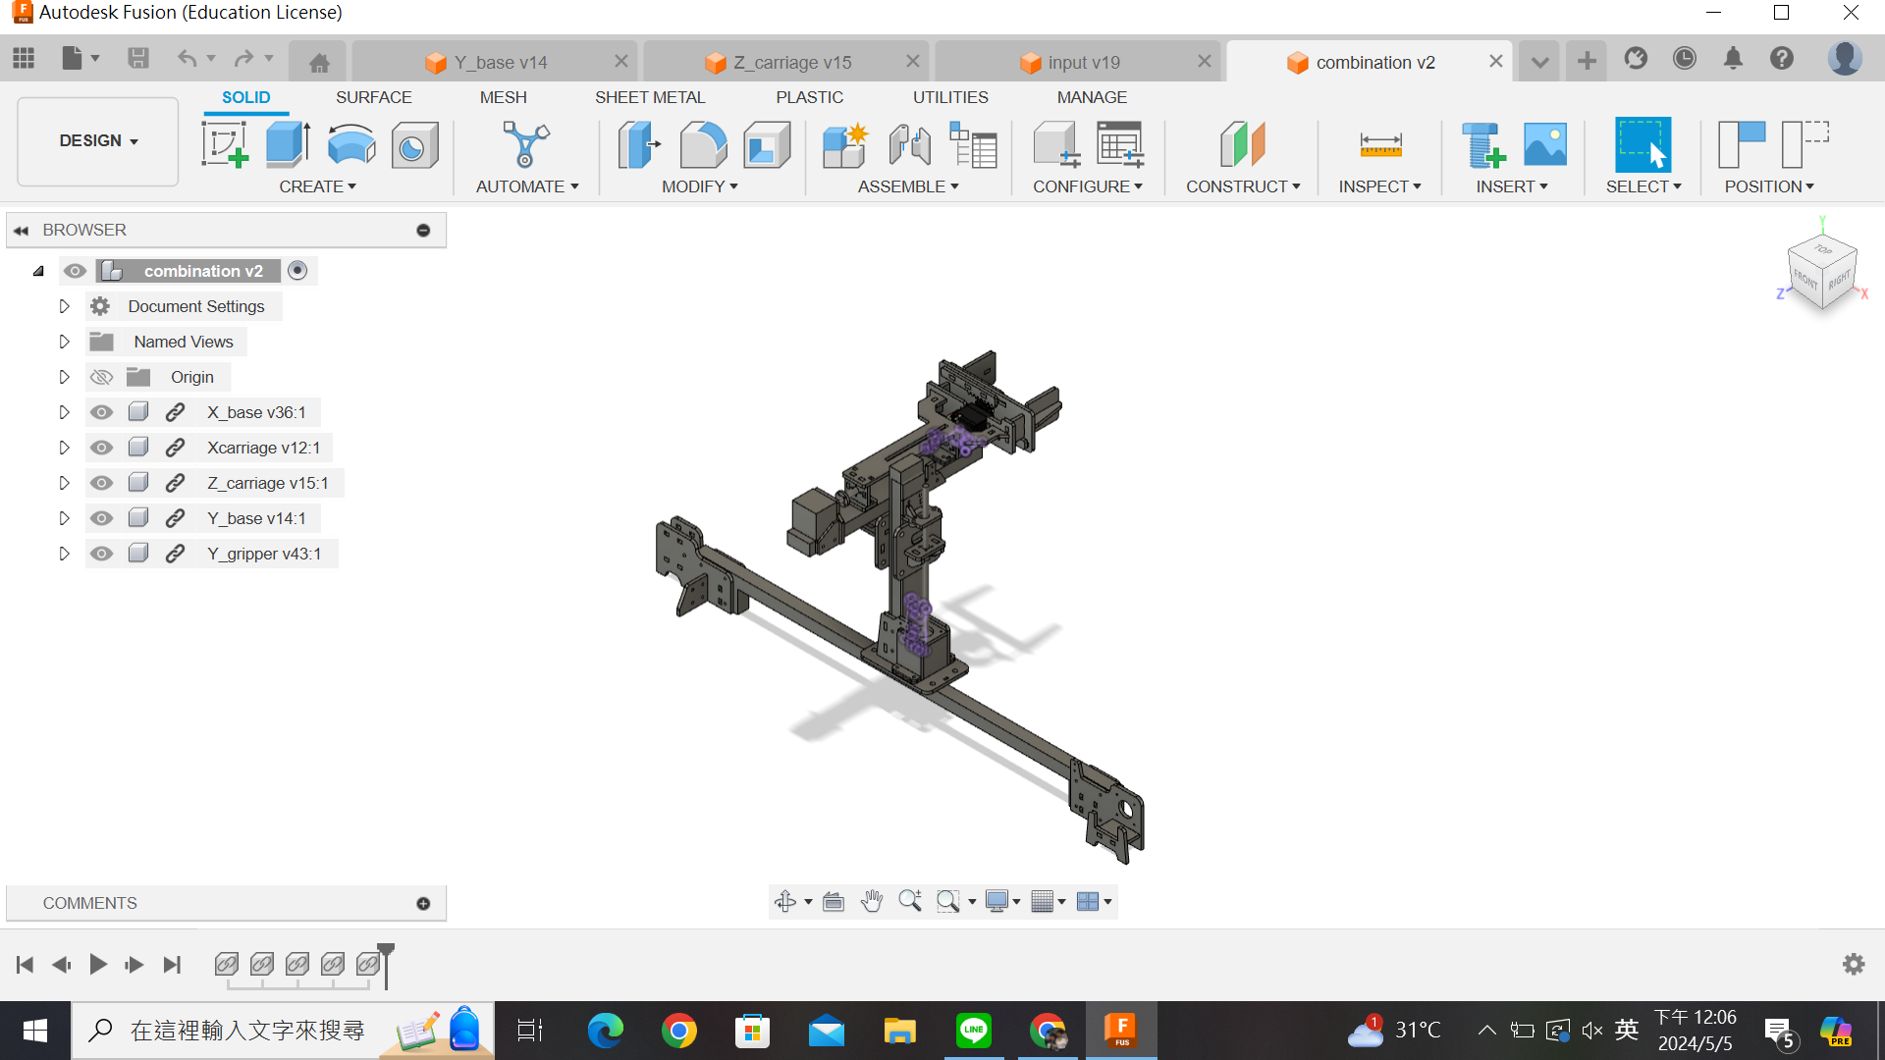

WHOLE DESIGN

Slide 14
HARDWARE
POWER SUPPLY
powered by a Type-C charging cable

Slide 15
CONTROL
MICROPROCESSOR
RPI (Raspberry Pi) integrates both the software and hardware

Slide 16
CONTROL
POSITION CALIBRATION
Limit switches are installed at the end of each axis. When the device hits a limit, a signal is sent back to reset the position to zero.
ENERGY SAVING
The system automatically shuts down when idle to save power.

Slide 17
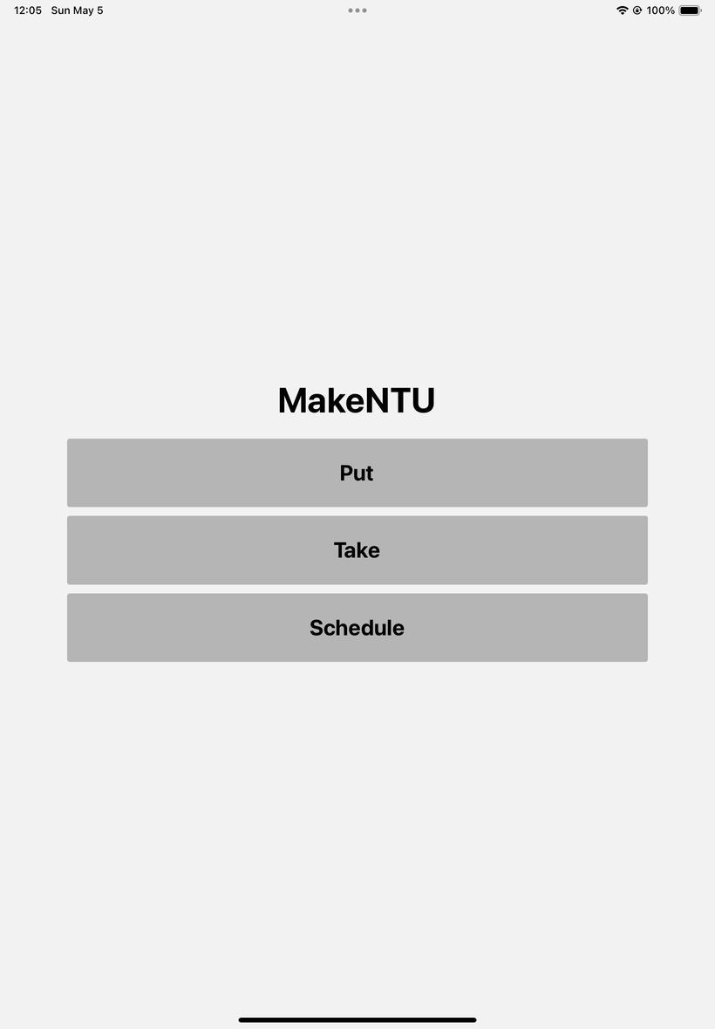
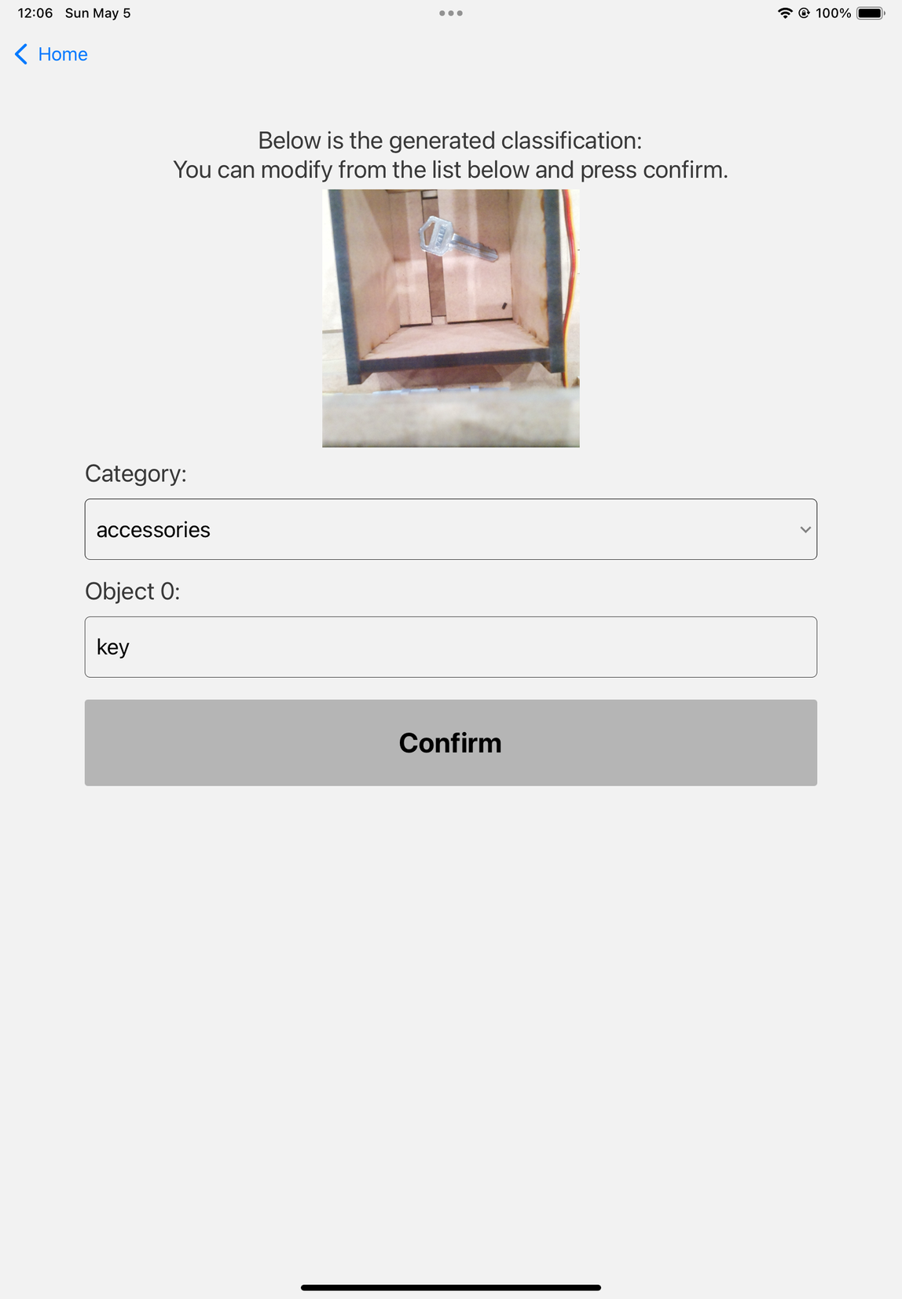
APP
COMMUNICATION
RPI connects and facilitates communication between software and hardware
SEARCH
After an item is scanned and stored, you can search for it using keywords.
For example, to find a "bag," simply typing "b," "a," or "g" will bring up the item.

Slide 18
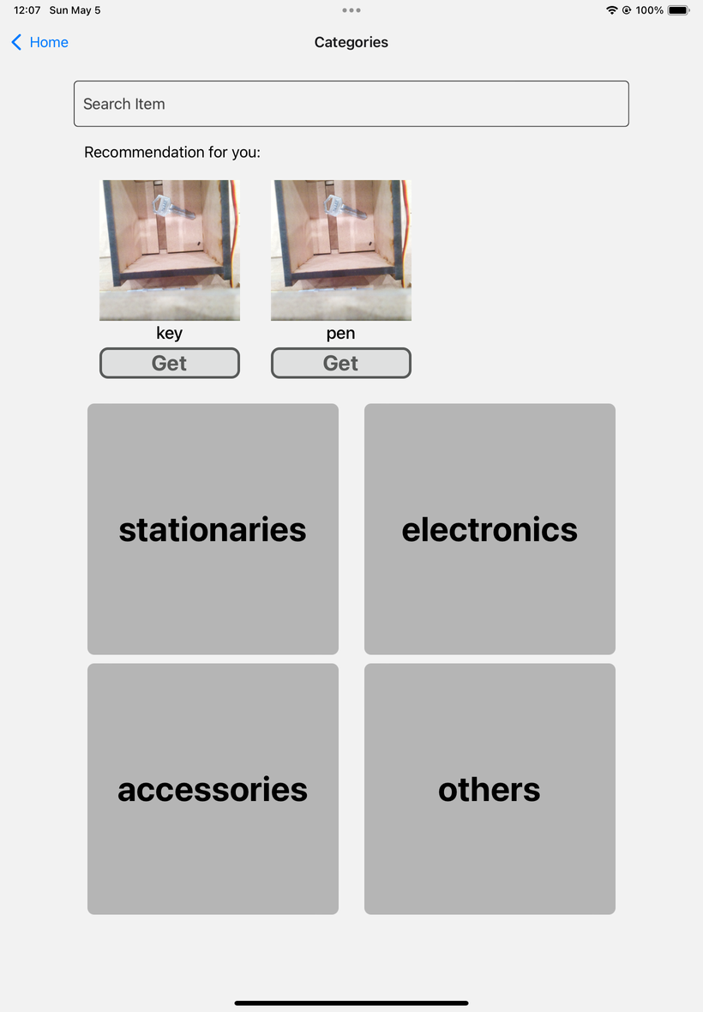
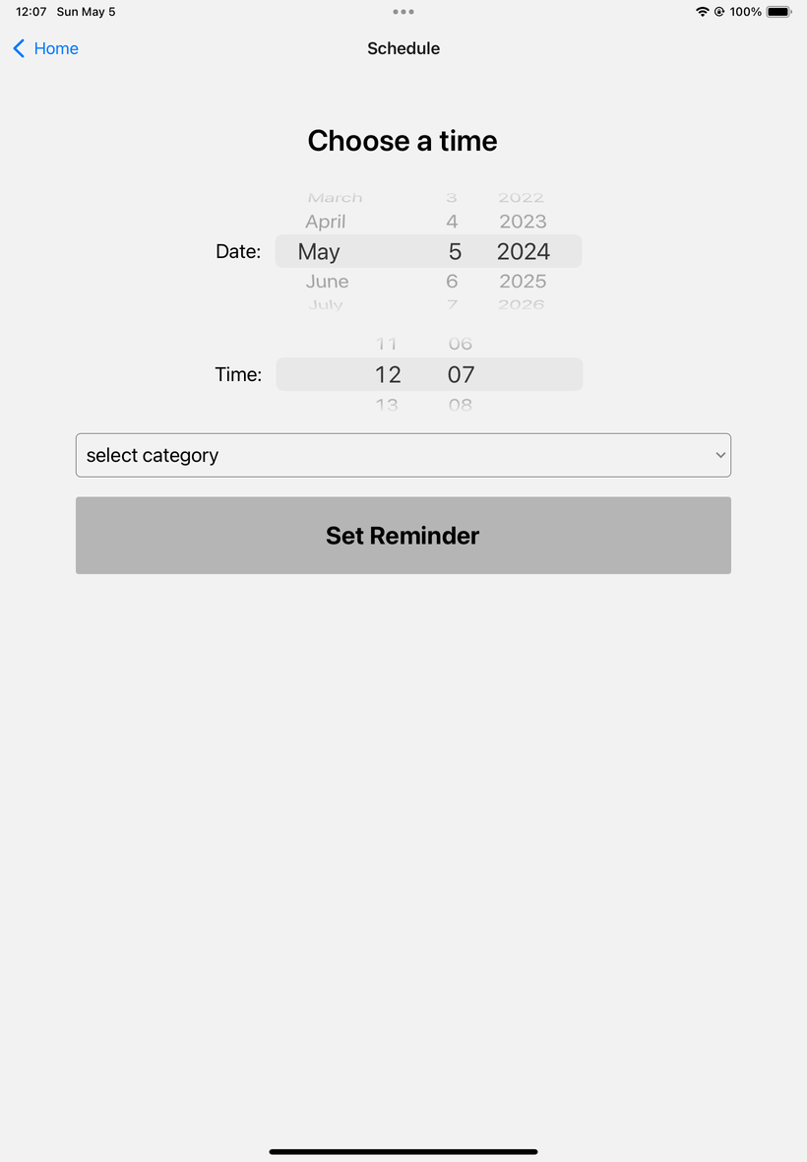
APP
RECOMMENDATION
The app records items retrieved during morning, afternoon, and evening hours. It then recommends items on the retrieval interface based on the time of day and recently viewed items.
SCHEDULING
Users can set a specific time to retrieve an item. The system will send a notification, and the mechanism will automatically operate.

Slide 19
CV
YOLO
Using You Only Look Once (YOLO) v8 technology and a custom-built dataset of everyday items, the system detects and classifies photographed items, returning the item's name and category.

Slide 20
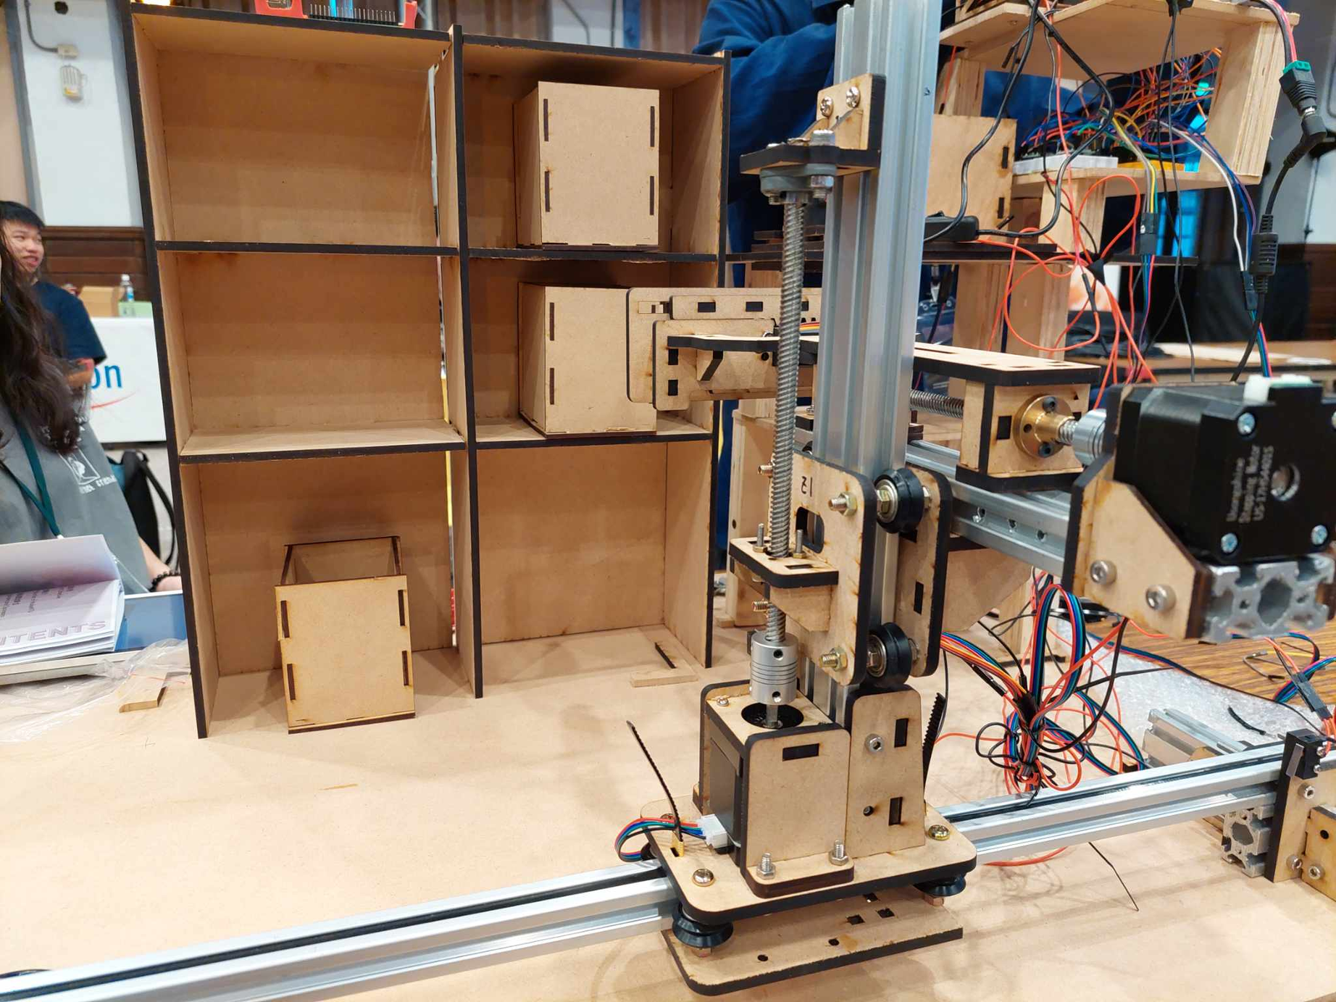



FUTURE GOALS
SCALE UP
Parts are designed to be easily assembled and disassembled, making it simple to increase or adjust the size of the system.
OLINE TRAINING
The image recognition model will be further trained using photos uploaded by users.
AUTO PARAMETER GENERATION
We will use computer vision to calculate distances, reducing the need for manual calculations.

Slide 21
DEMO

Slide 22
DEMO

Slide 23
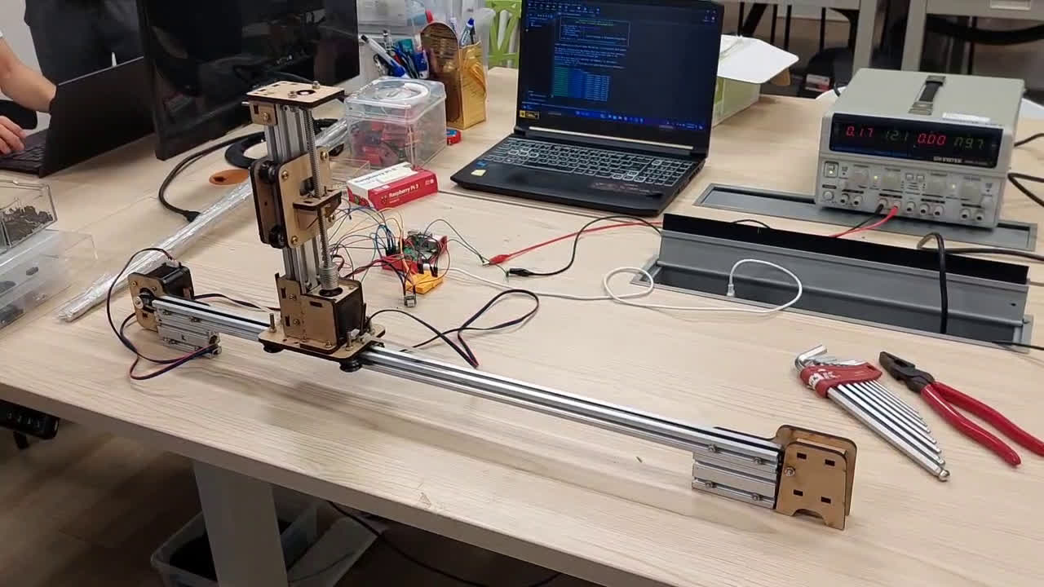
DEMO

Slide 24
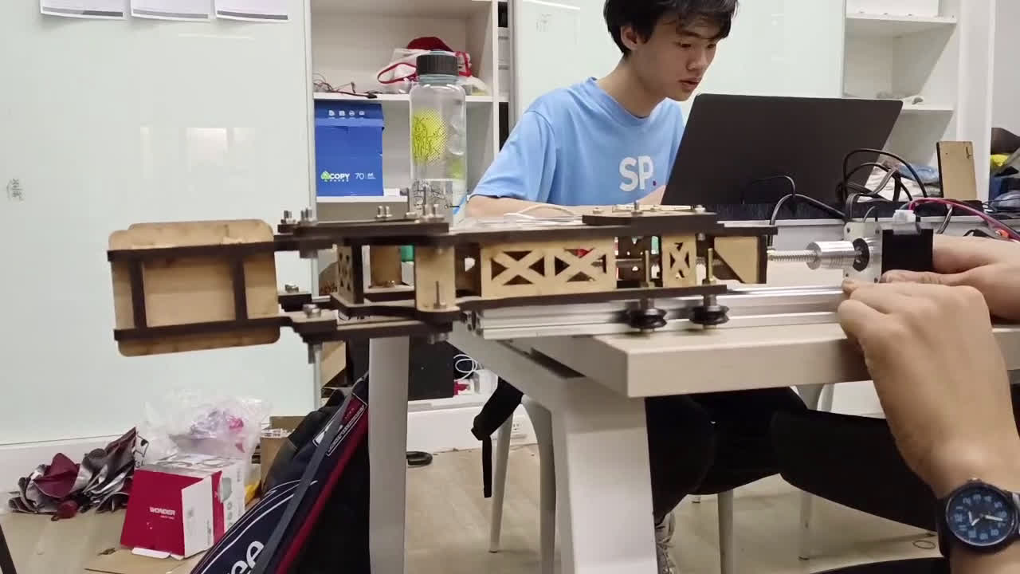
DEMO

Slide 25
DEMO

Slide 26
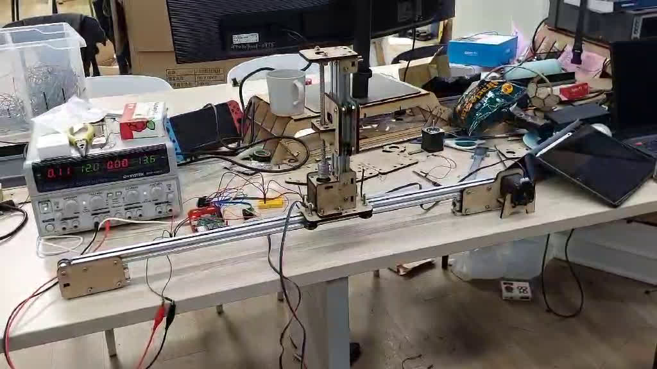
DEMO

Slide 27
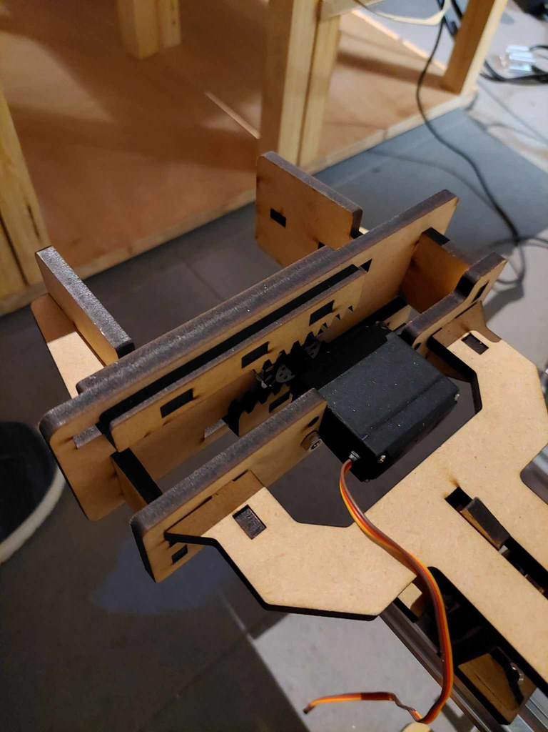
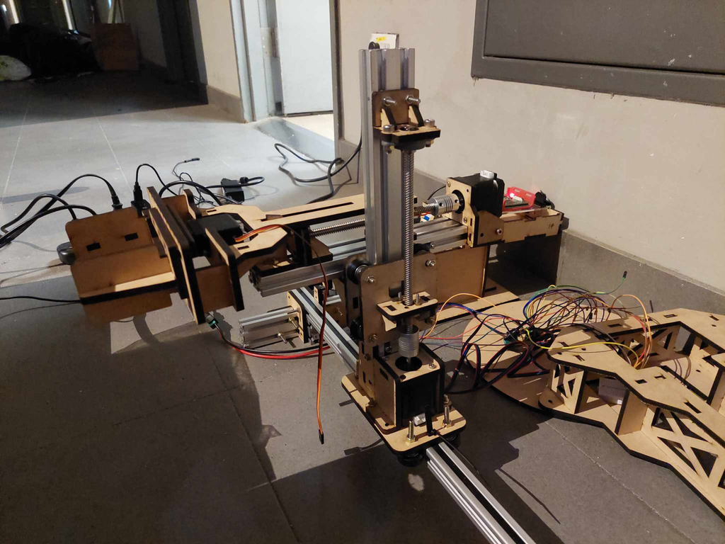
DEMO

Slide 28
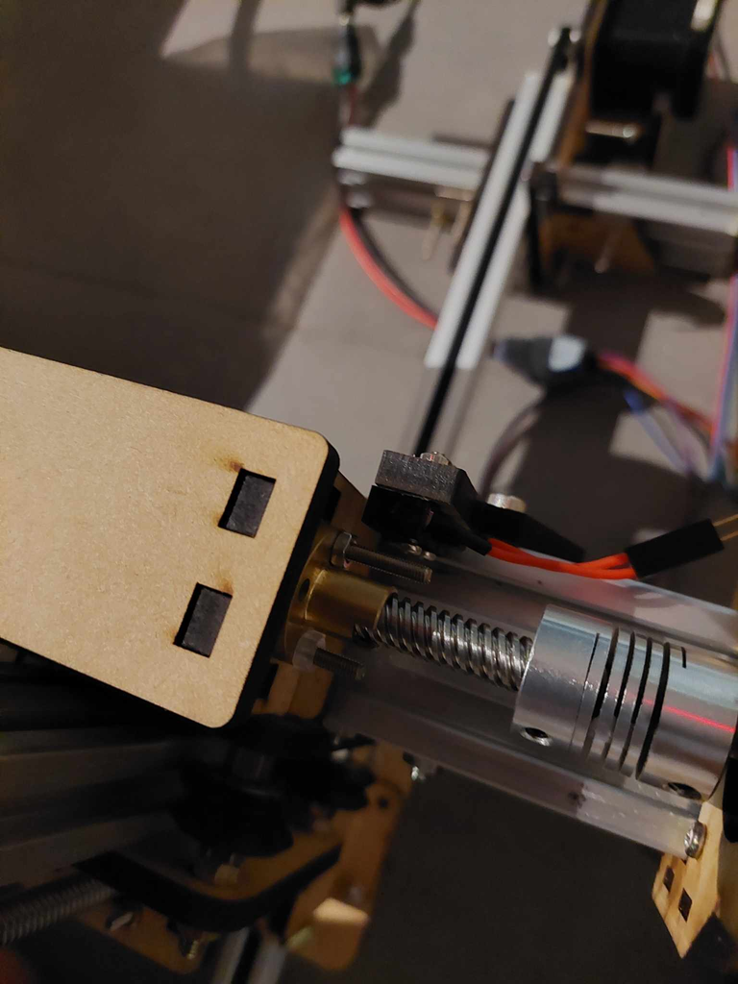
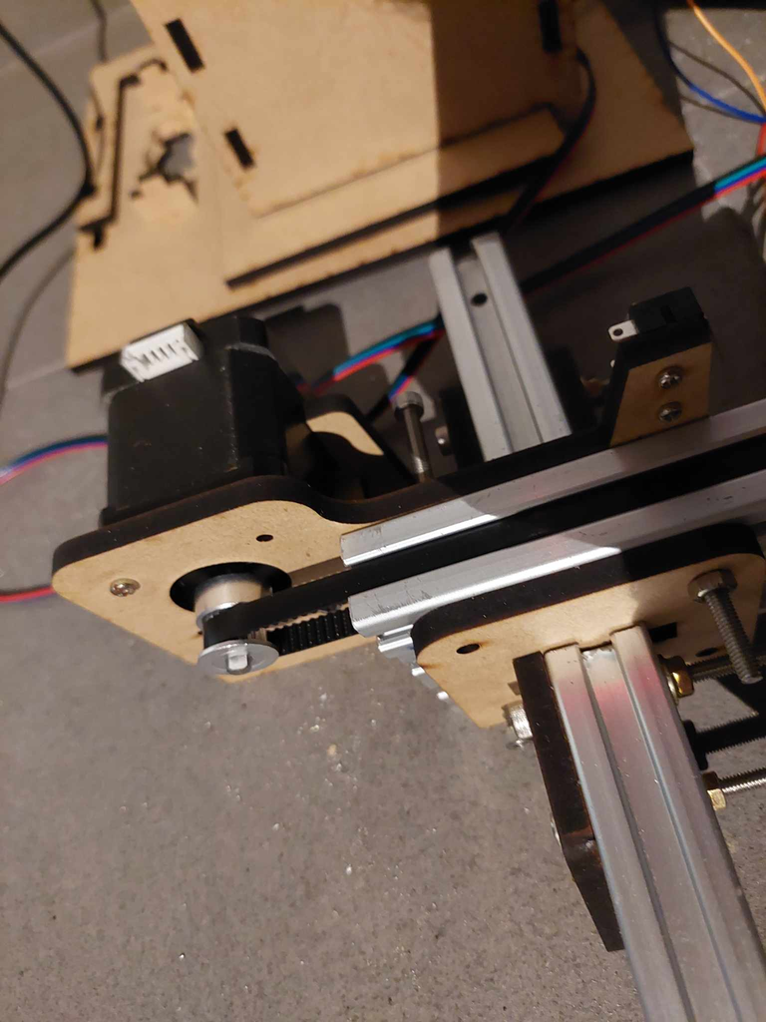
DEMO

Slide 29
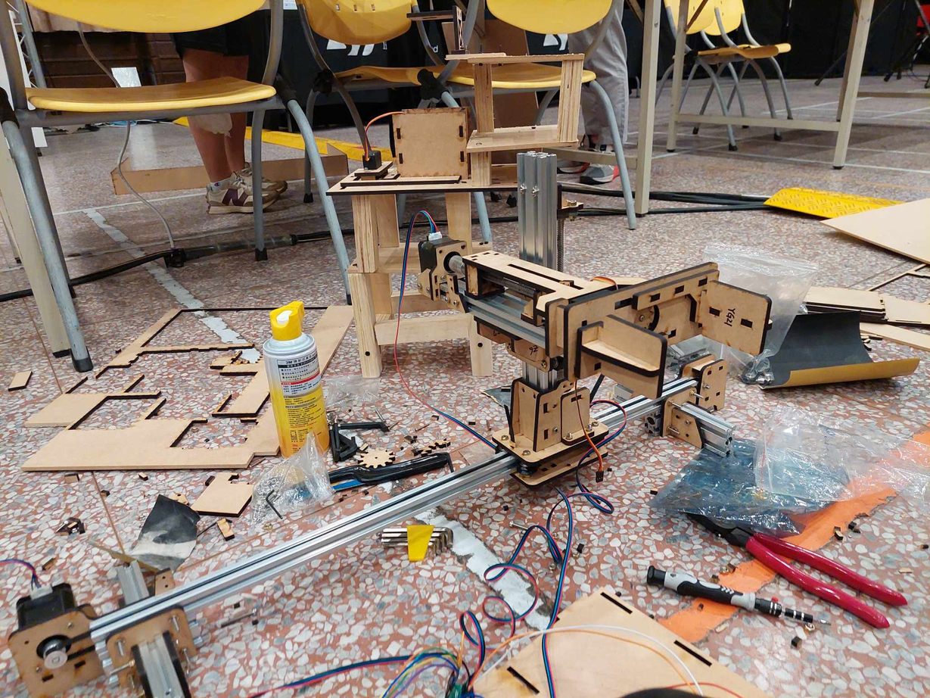
DEMO

Slide 30
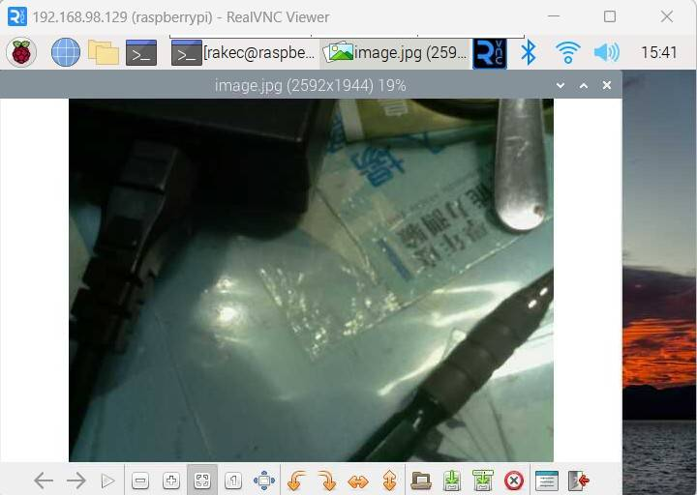
DEMO-RPI CAMERA

